Slide 1
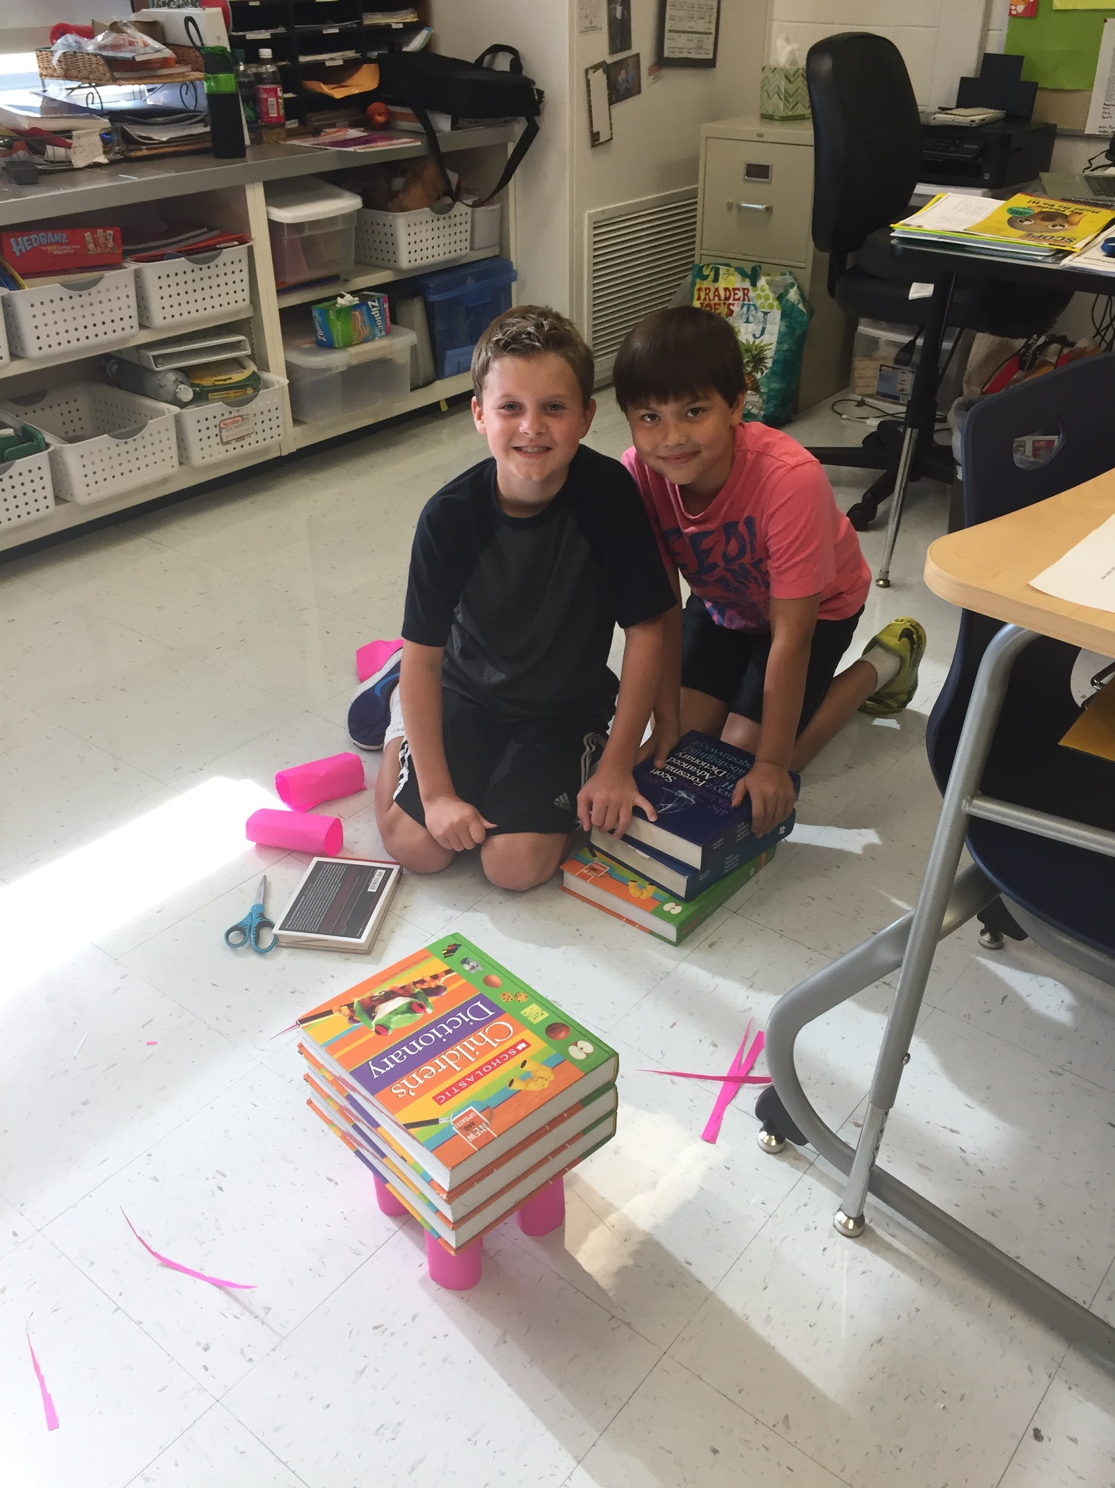
Challenge Curriculum Night
2016- 2017

Slide 2
CCSD89 Challenge Teachers
Morgan Aiello - Arbor View
Derek DesJardins - Briar Glen
Jessica Bainter - Park View
Sue Pumo - Westfield

Slide 3
How are students identified? Achievement/Ability
S.T.E.M.
MAP: 93% national percentile minimum average [last 4 math scores with lowest dropped]
CogAT: 93% national percentile minimum of composite Quantitative/Nonverbal scores
LA/H
MAP: 93% national percentile minimum average [last 4 reading scores with lowest dropped]
CogAT: 93% national percentile minimum of Verbal Score

Slide 4
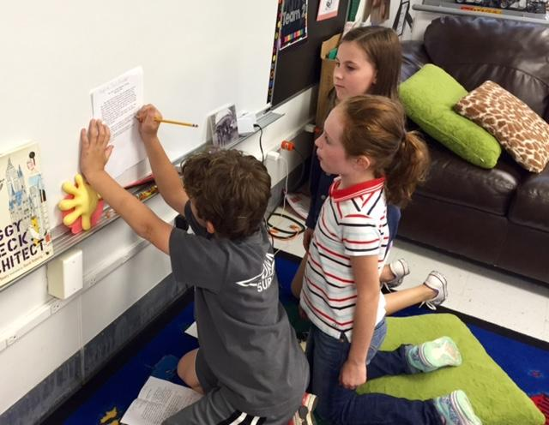
How do students maintain eligibility?
Students identified for Challenge are expected to:
-Exceed on grade-level standards for the identified subject in regular classroom
-Maintain a performance level of 93%+ average on relevant MAP scores
-Engage appropriately with Challenge material

Slide 5
Challenge Units
There are certain units taught at each grade level in Challenge, subject to variation year to year.
STEM LAH
Algebra/Geometry/Measurement Classics, Non-Fiction (2+ levels)
Design/Architecture/Bridges Analogies/Latin/Wordmasters
3-D Printing/Coding/Robotics Research/Presentations/Drama
CML Math Contests, Energy Past and Present Cultures/History
)
,
Notes:
Define STEM for parents (technology interweaving); mention Common Core and NGSS

Slide 6
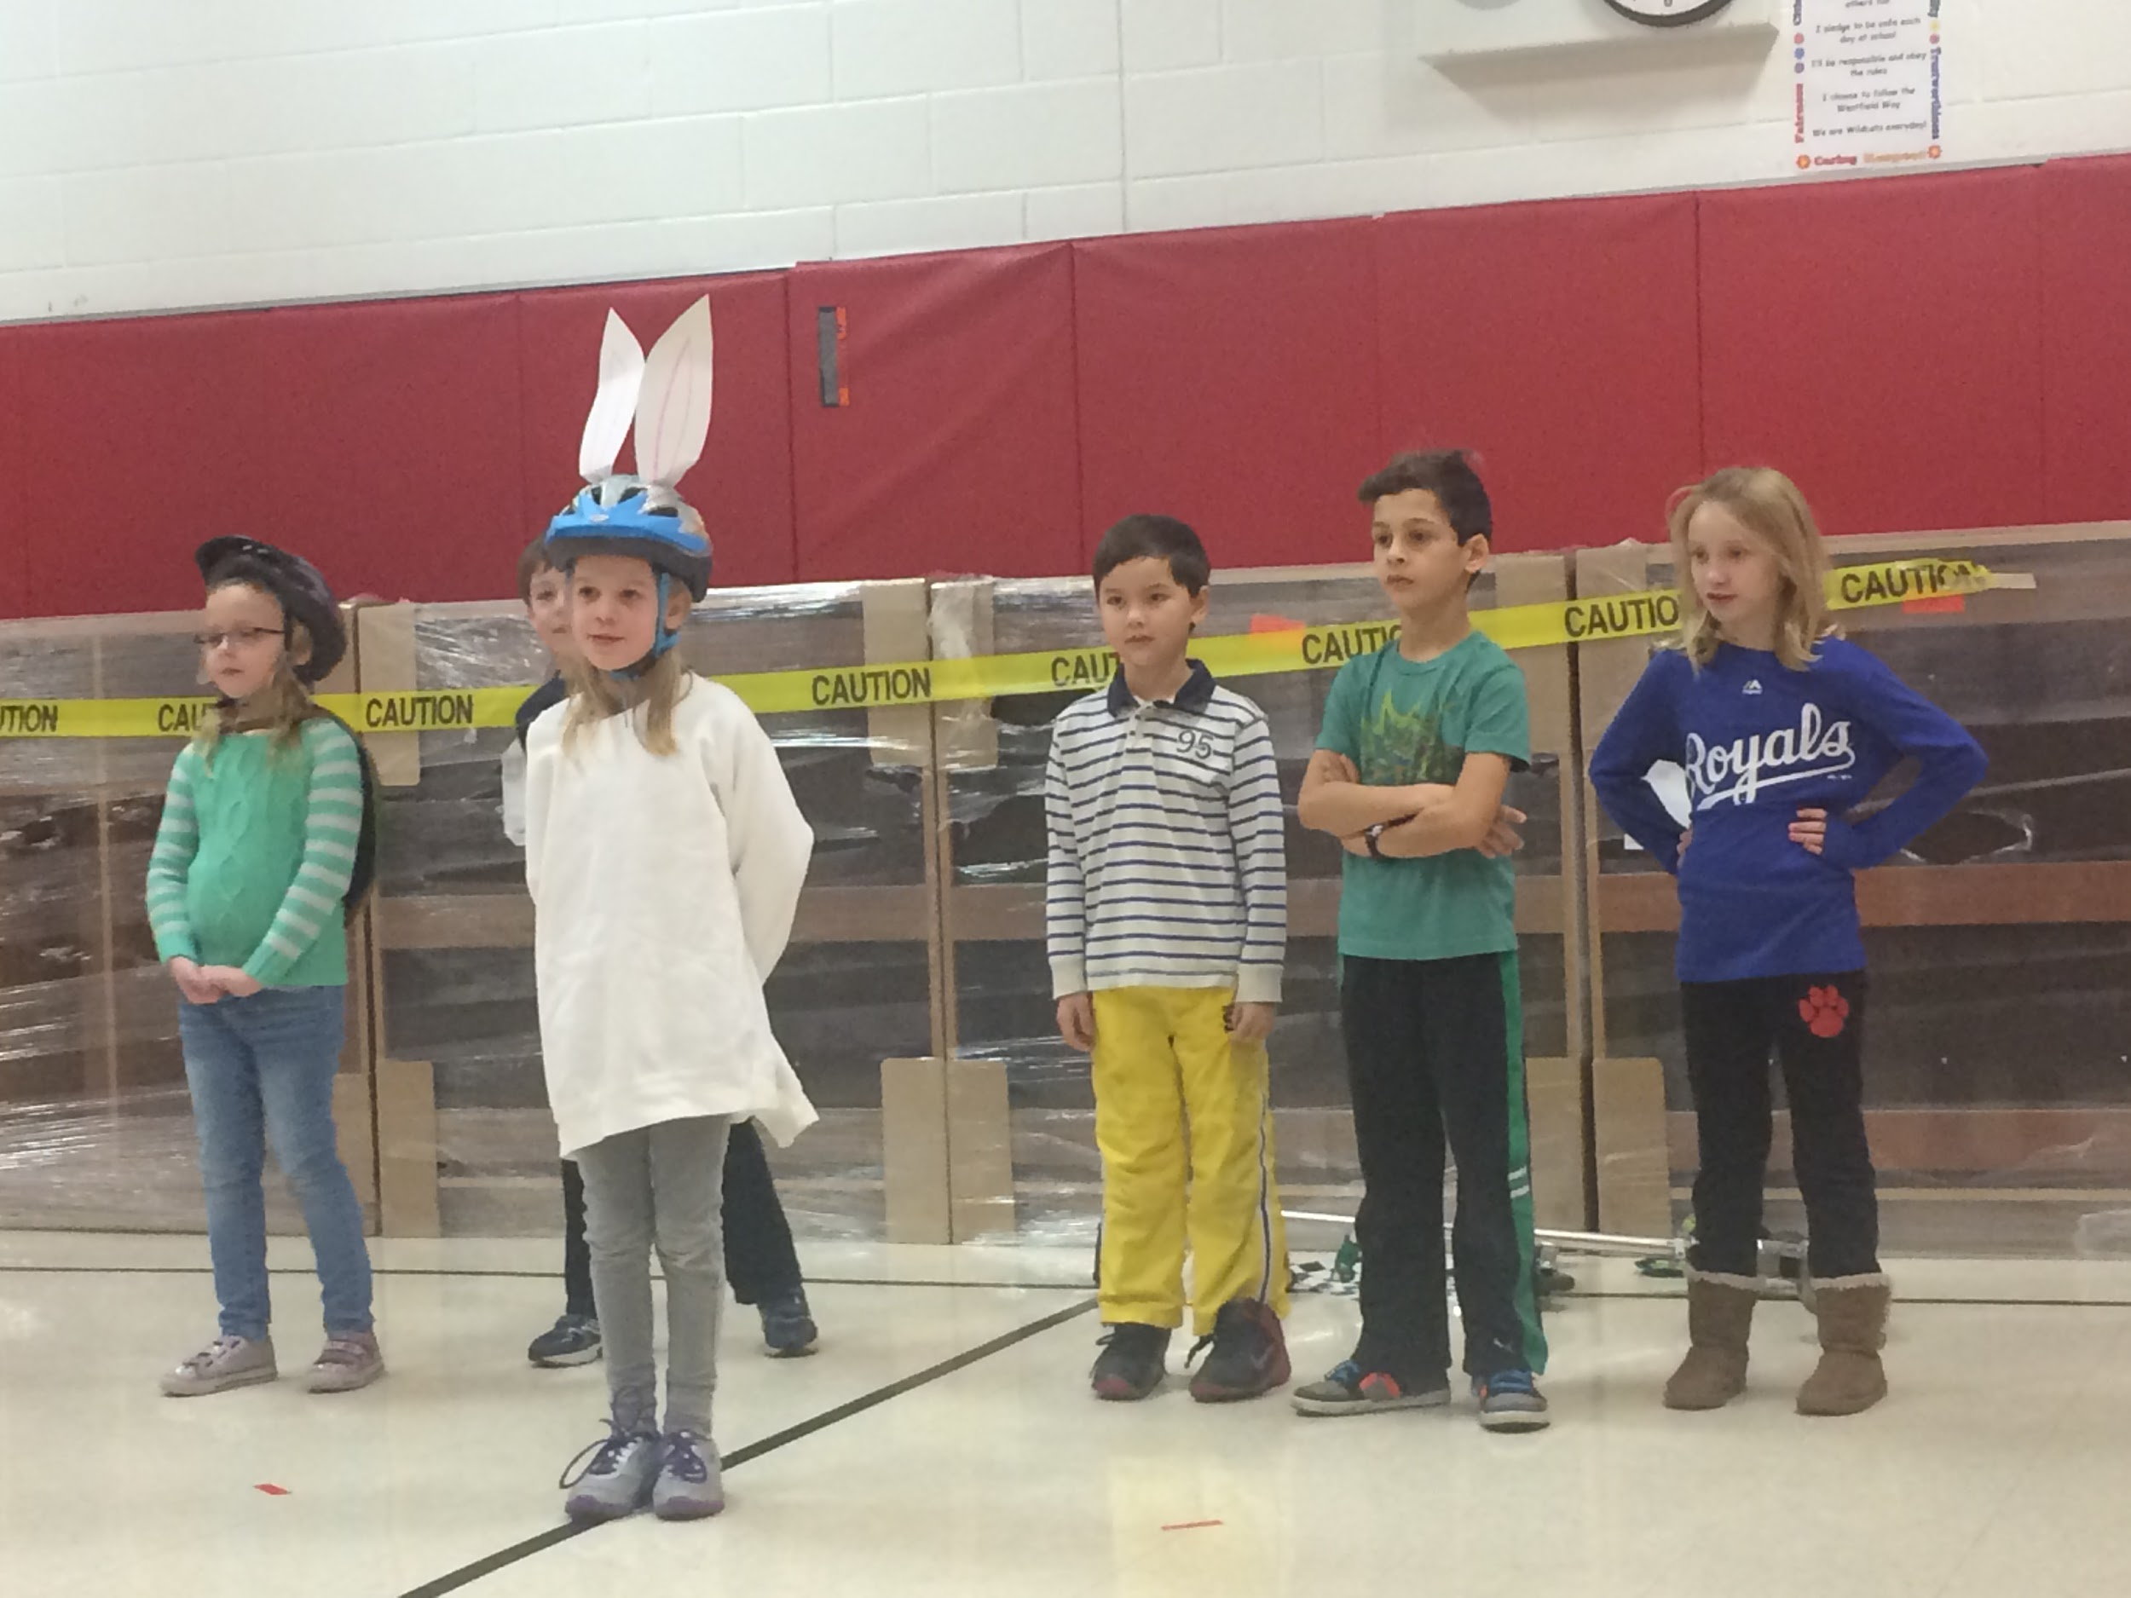
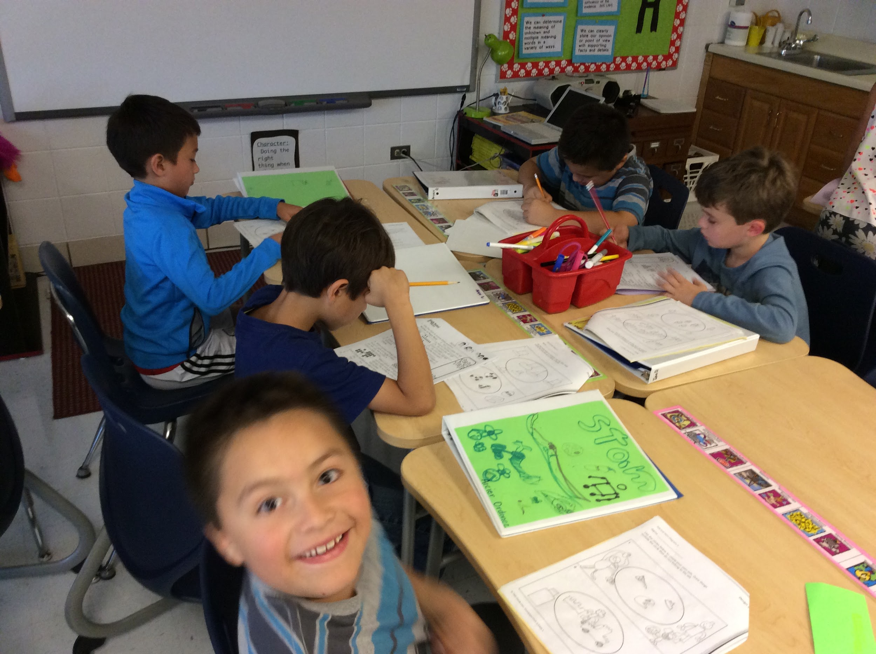
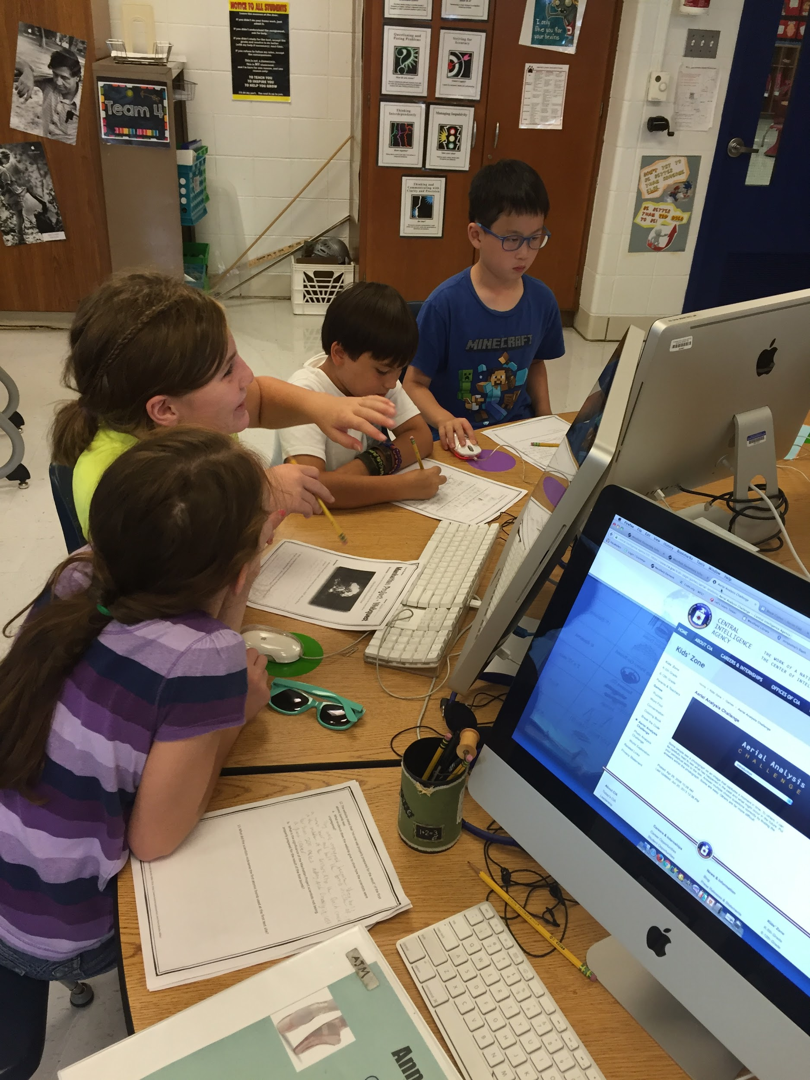
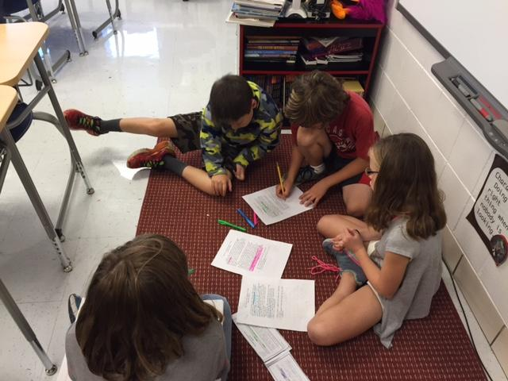
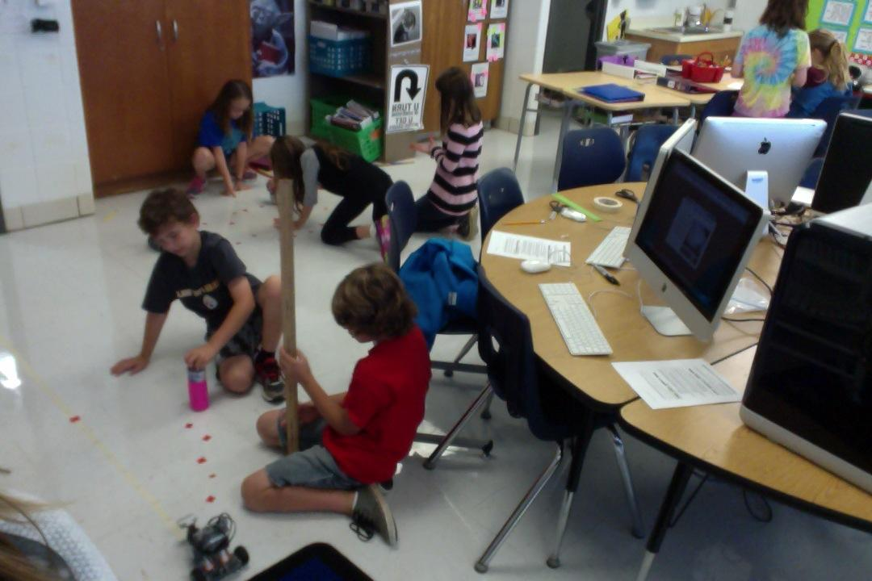
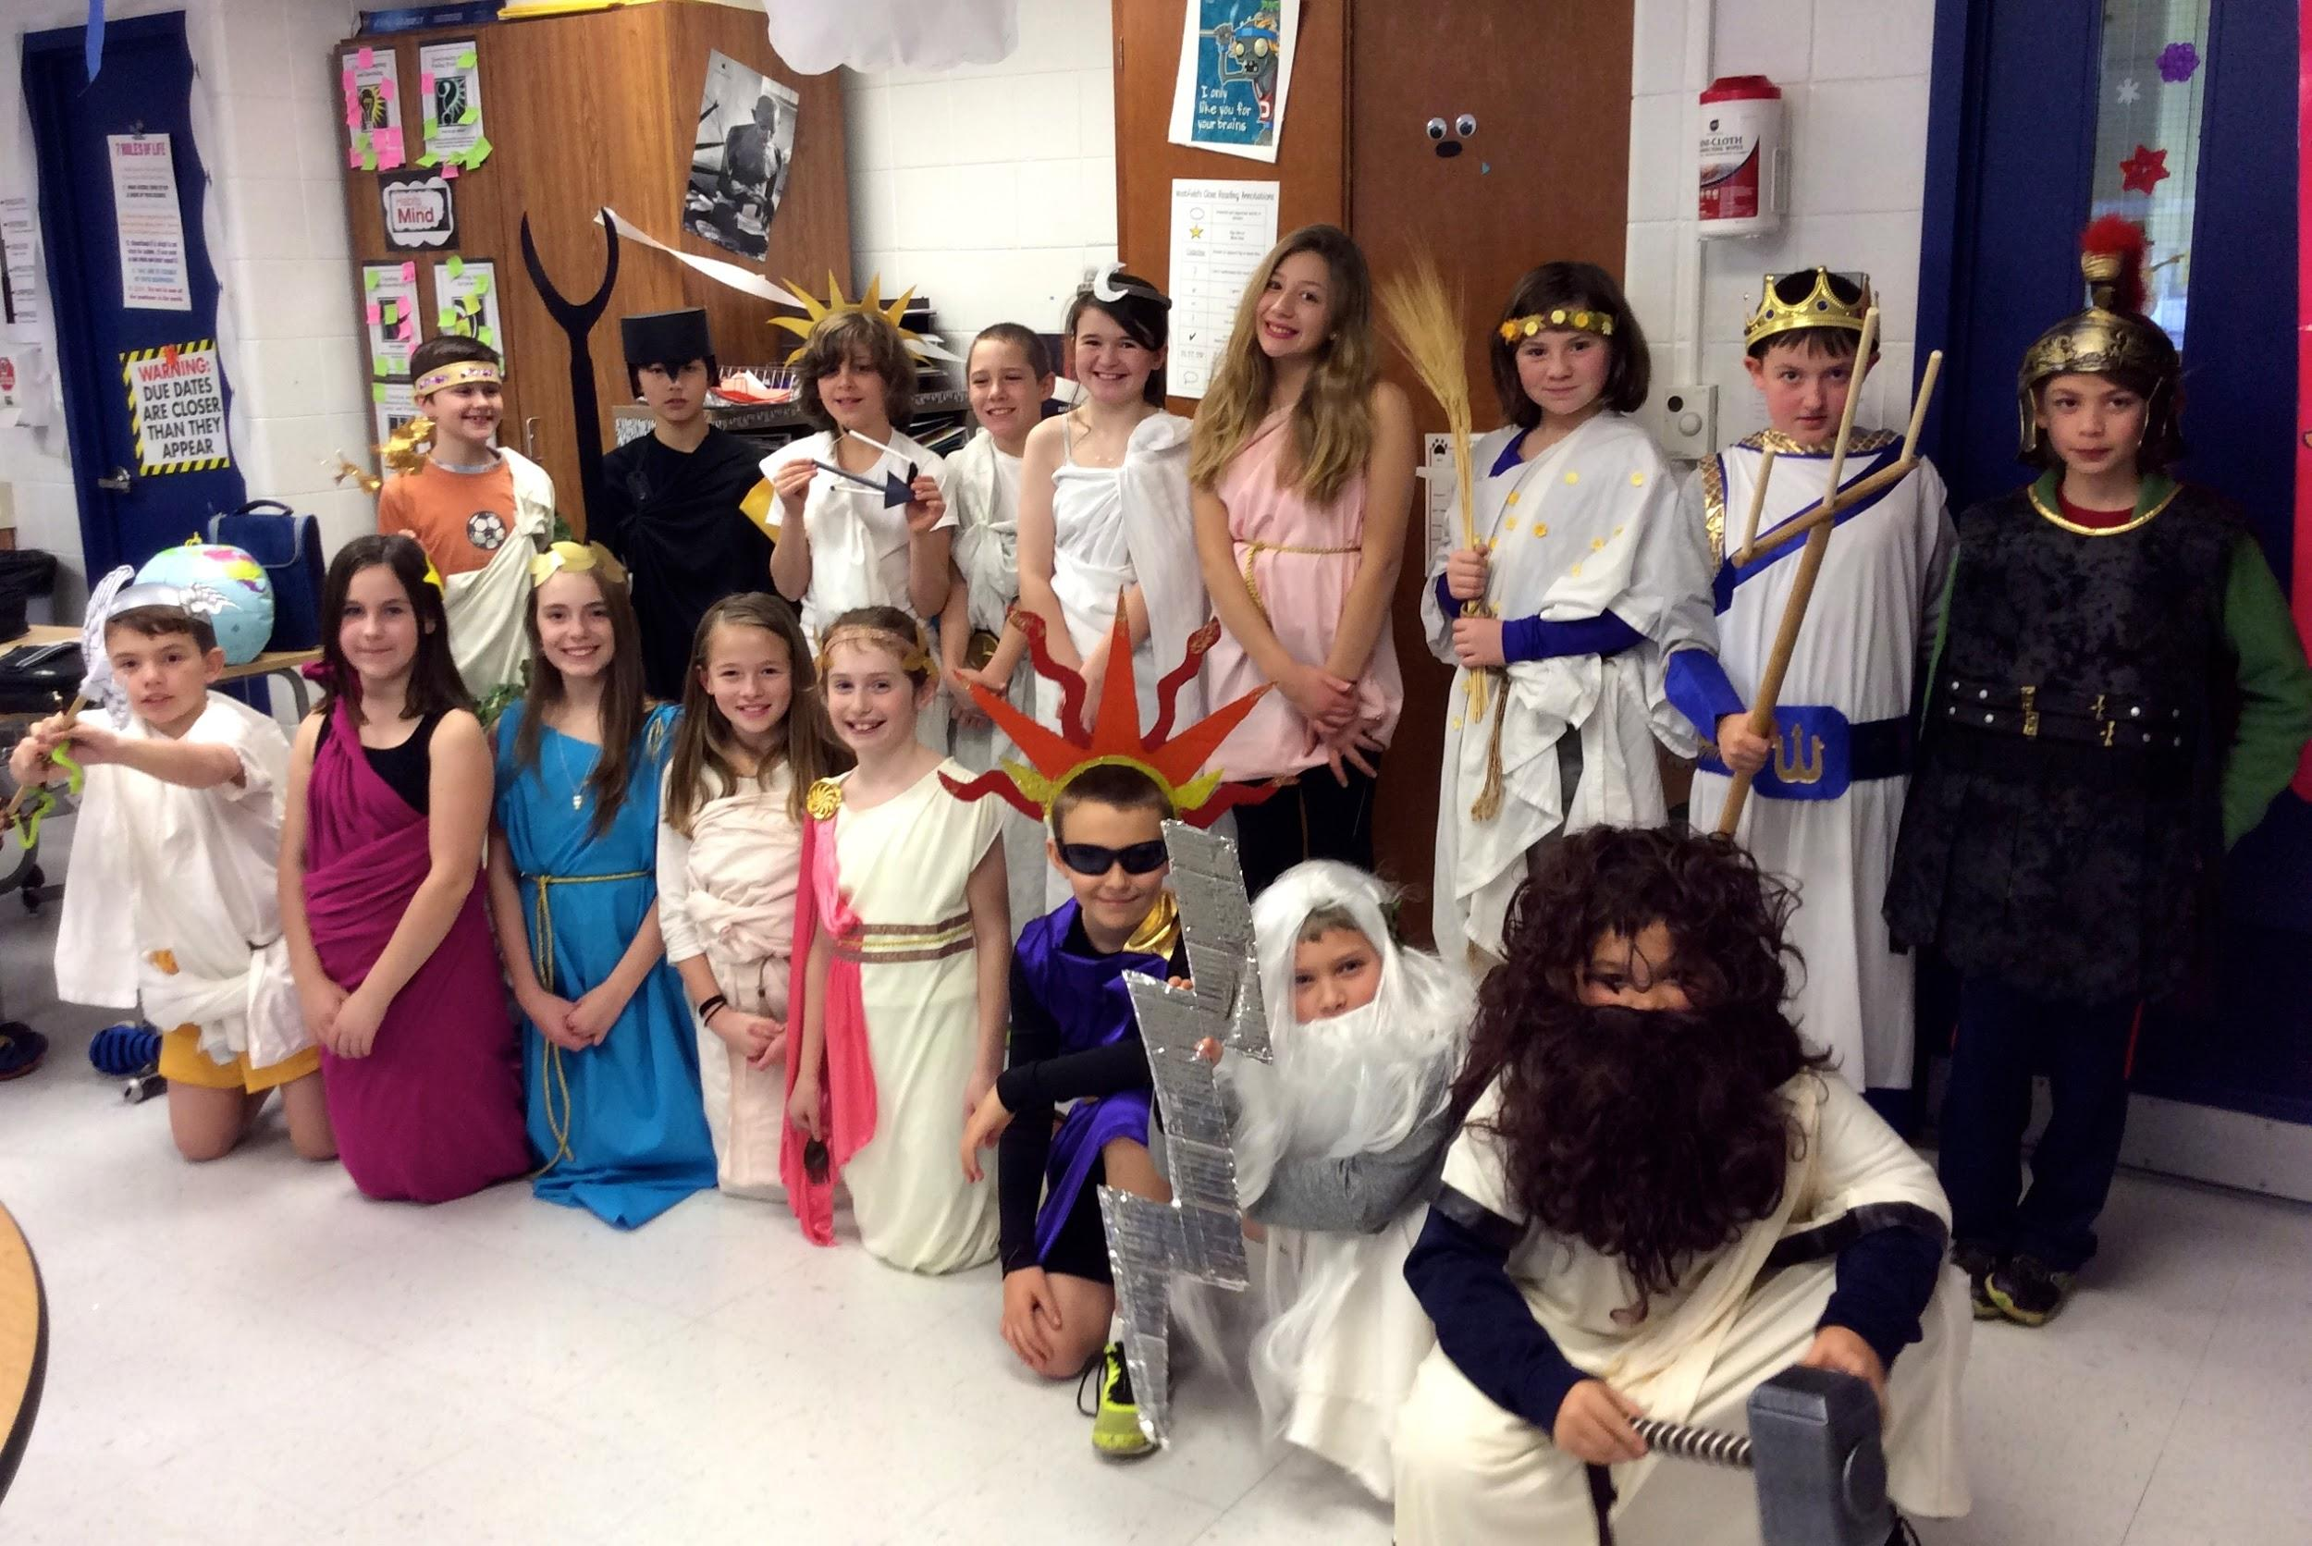
FUN!

Slide 7
Assessing Student Progress
Challenge assessment aligns with assessment practices with those of the regular classrooms such as:
using B, P, M, E as descriptors of performance relative to Challenge expectations
- development of shared units with pre- and post-assessments
- continued reliance on formative observations and the use of high-level questioning to assess student understandings and misconceptions
- focus on student self-reflection
- the importance given to the development of Habits of Mind
Notes:
A focus on the notion that many of the things we do in Challenge do not lend themselves to quantitative assessment

Slide 8
Scheduling, Homework, and Communication
Challenge schedules are built around building schedules, usually overlapping with the analogous classroom subject
Students are usually assigned homework early in week. Homework is posted on website.
Conferences, newsletter, website, and email - spumo@ccsd89.org
Thanks for coming this evening!

